Slide 1
The Role of Vibrational Excitations
in N2 Dissociative Chemisorption
on Ru(0001) for Catalytic Processes
Floris van den Bosch
N. Gerrits, J. Meyer.
Leiden University

Slide 2
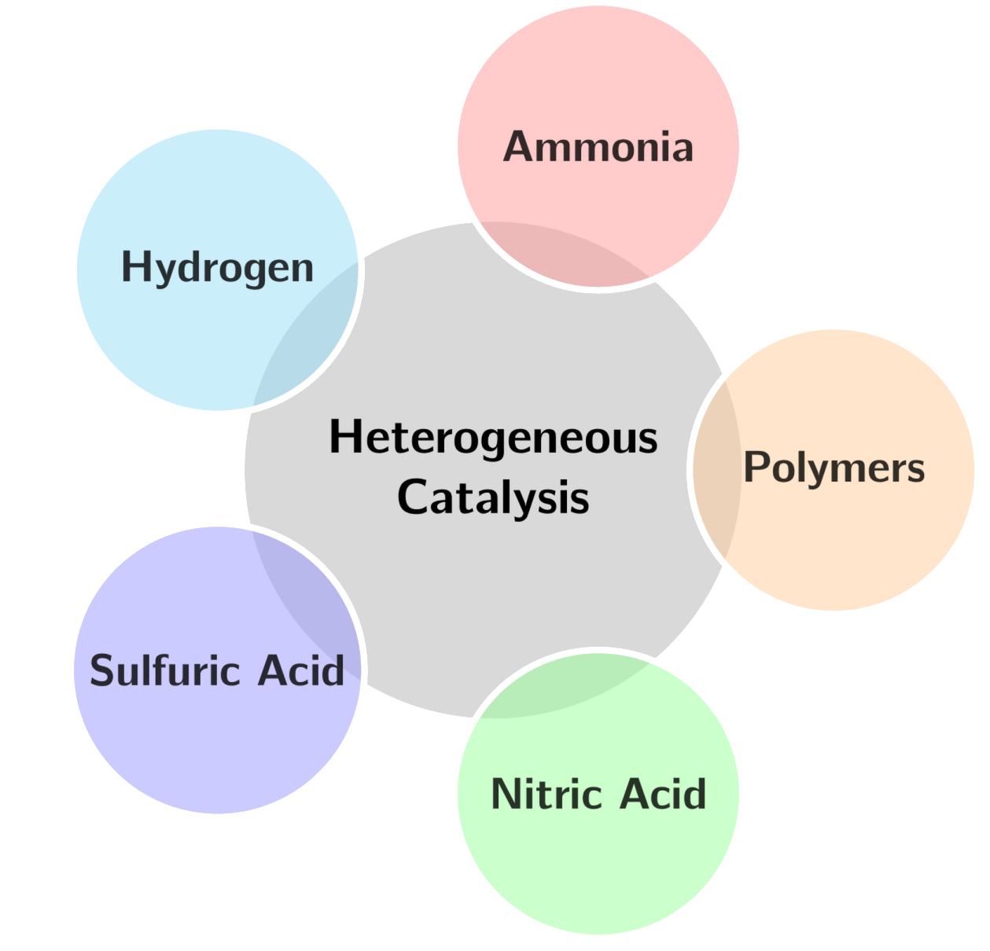
Heterogeneous Catalysis
Highly activated
Extreme reaction conditions
High energy usage

Slide 3
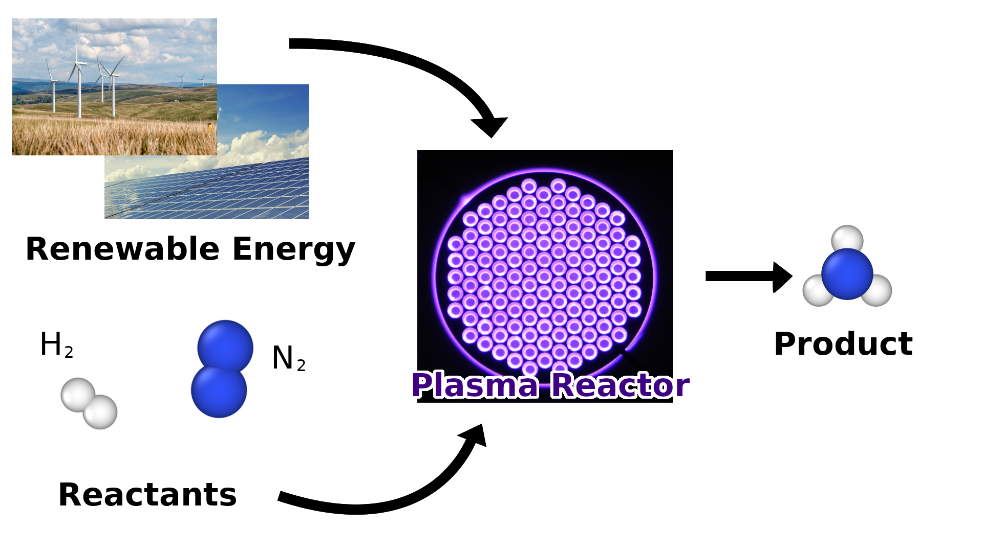
Plasma Catalysis
Efficient Activation
Instant on/off switching
Mechanism poorly understood

Slide 4
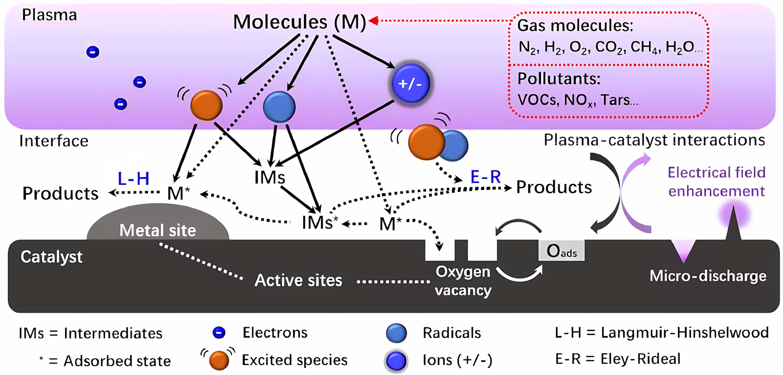
Plasma-Surface Interactions
Bogaerts, A. et al. ACS Energy Lett. (2018)

Slide 5
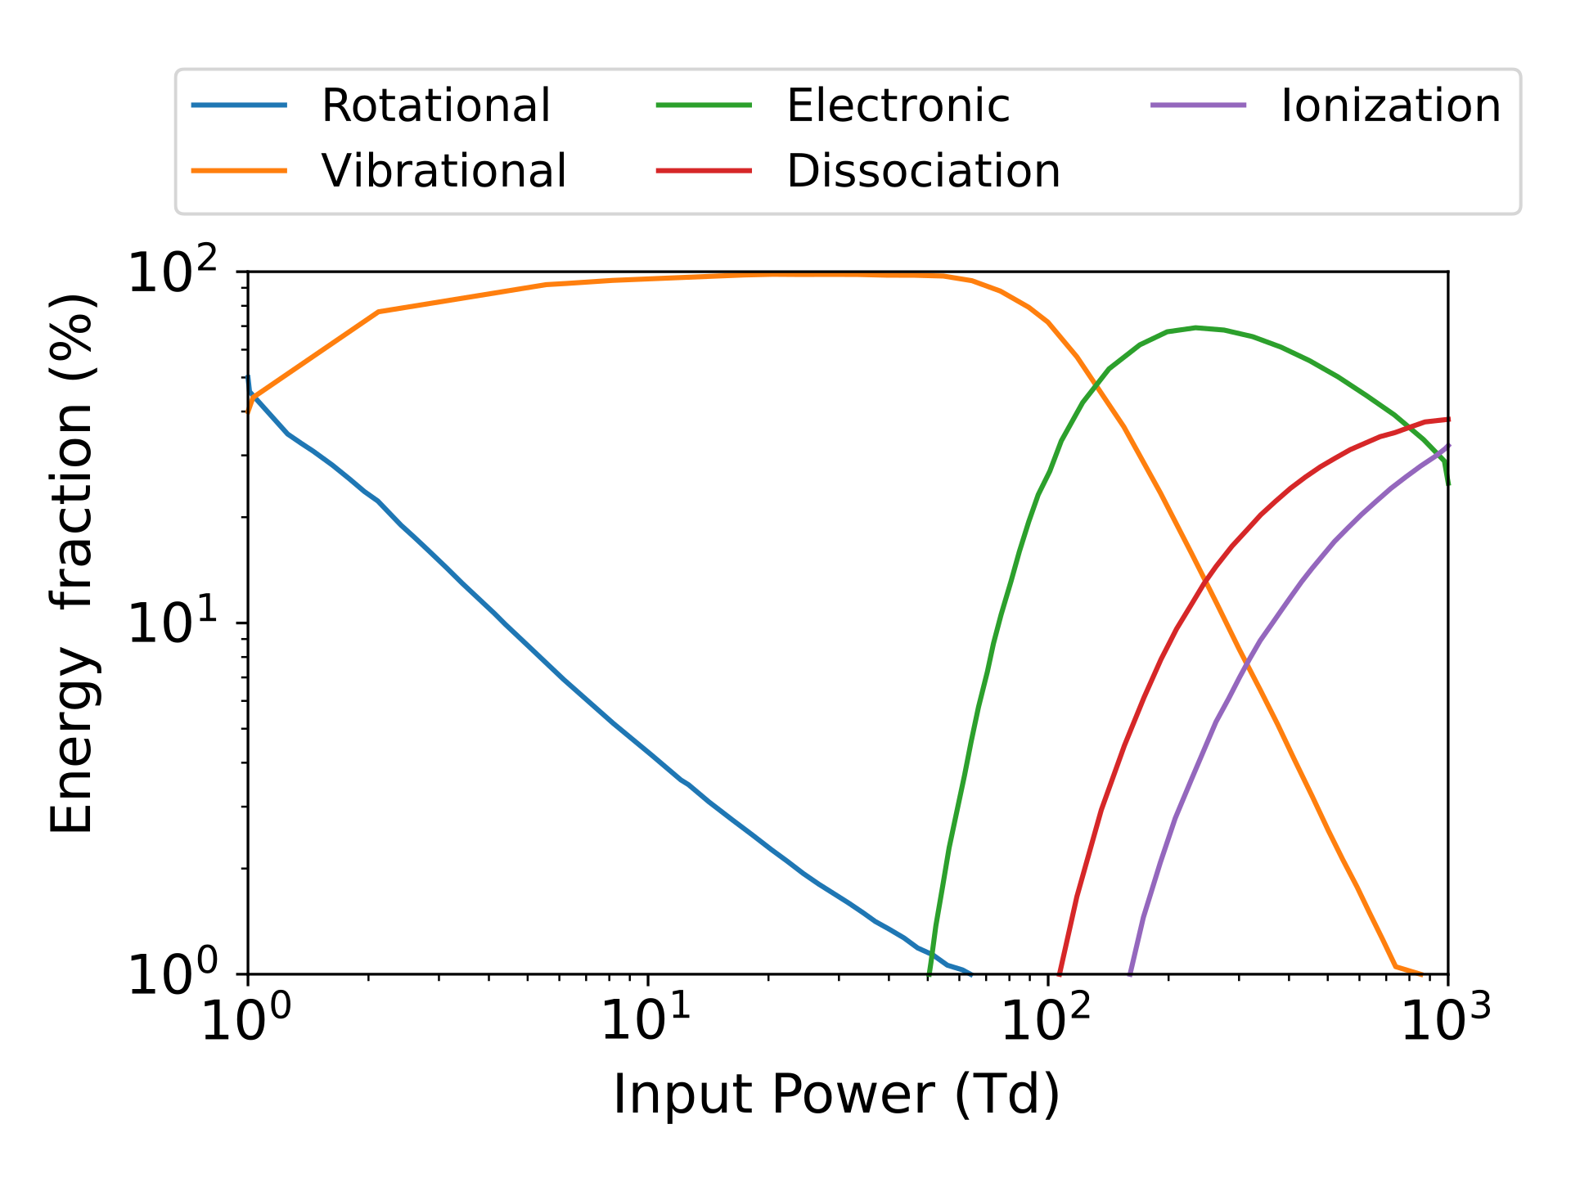
Vibrational Excitations
Energy channel depends on input power
Vibrational Excitations are major energy channel
Vibrations are long-lived
Bogaerts, A. et al. ACS Energy Lett. (2018)

Slide 6
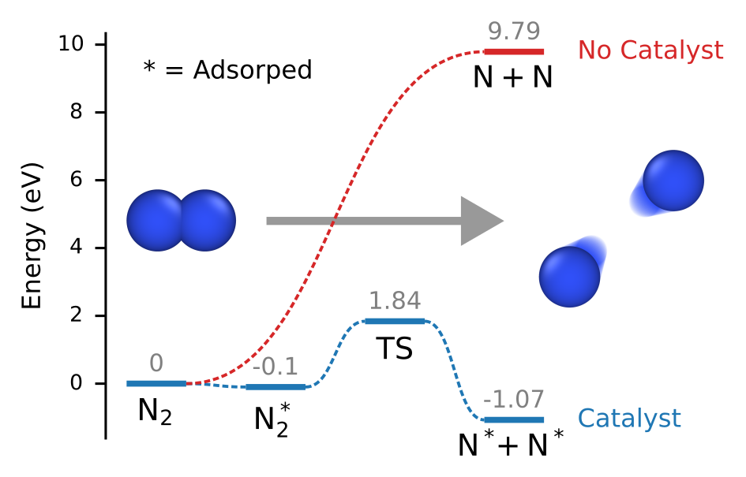
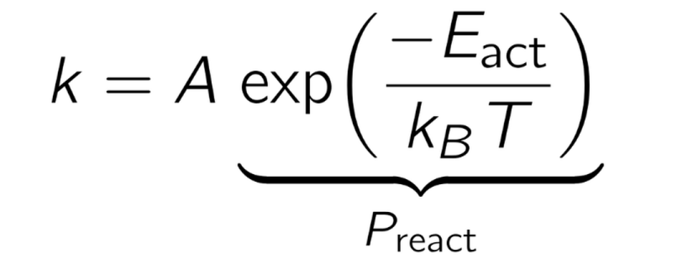
Nitrogen Dissociation
N2 dissociation is rate-limiting step
Ru(0001) surface lowers energy barrier to ~2 eV
Rate constant

Slide 7
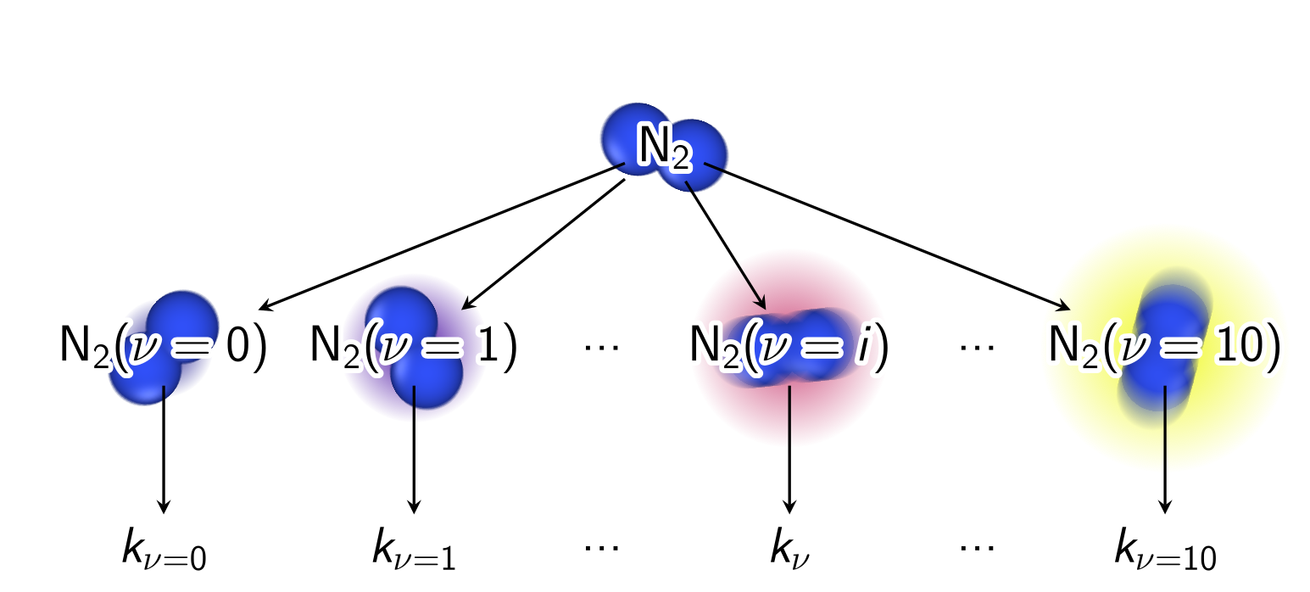
State-specific Rate Constants
Introduce vibrational quantum number dependent rate constants
Mehta, P. et al. Nature Catal. (2018)

Slide 8
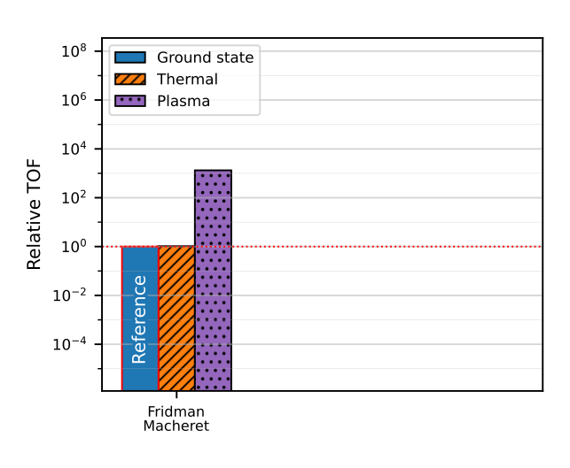
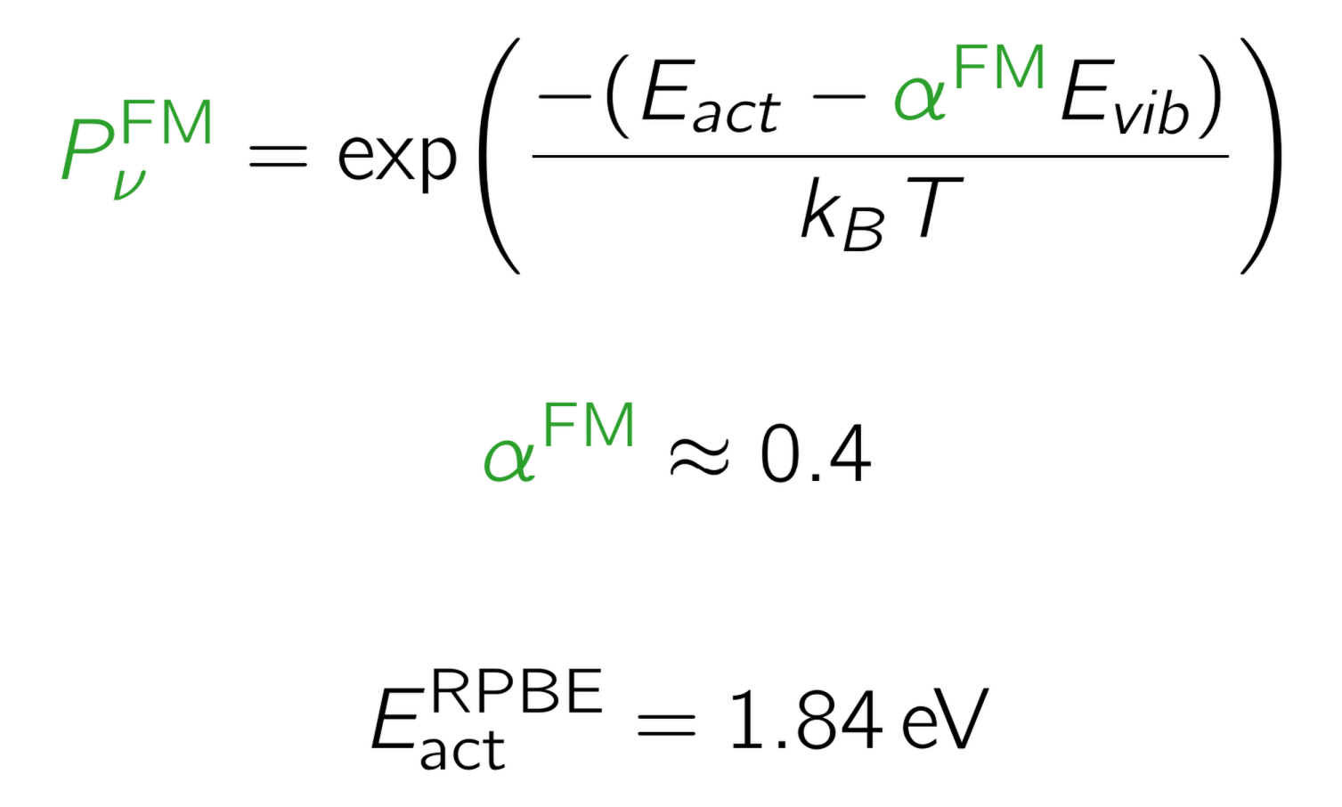
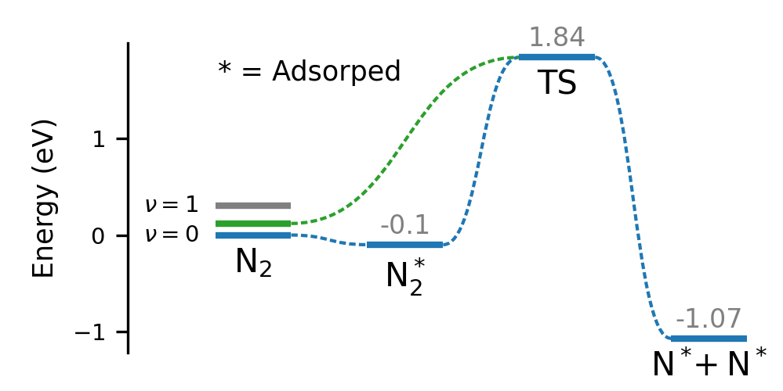
Fridman-Macheret Model
Microkinetic Modelling
Reducing energy barrier by fraction of Vibrational Energy
Fridman
Macheret
Mehta, P. et al. Nature Catal. (2018)
Fridman, A., “Plasma Chemistry”, CUP (2008)

Slide 9
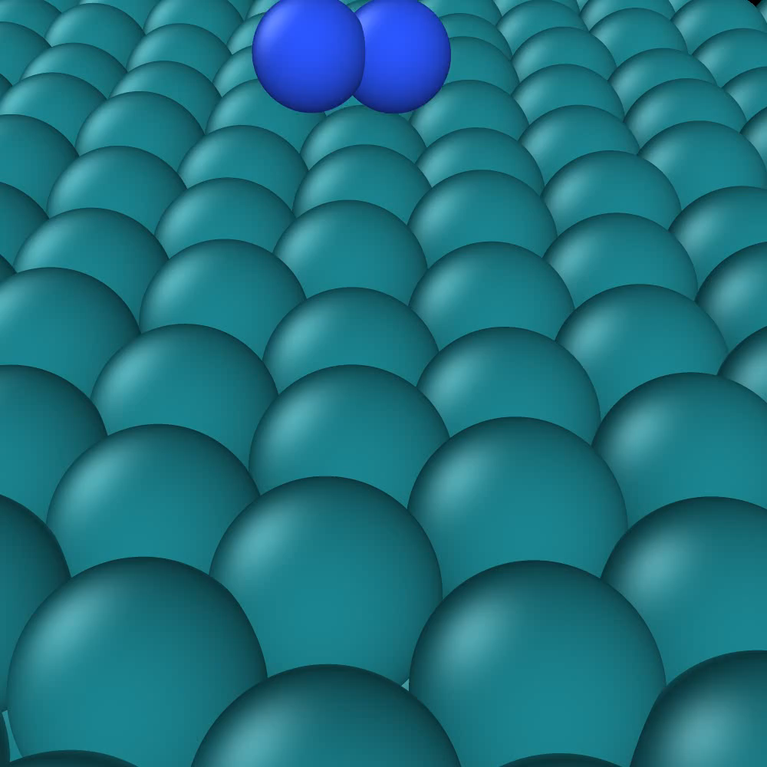
Quasi-classical Trajectories
Molecular Dynamics
  Quantized initial state
Surface motion
  Neural Network Potential¹
Computing Reaction probabilities
  Incidence energy
  Vibrational quantum number
¹Shakouri, K. et al. JPCL (2017)

Slide 10
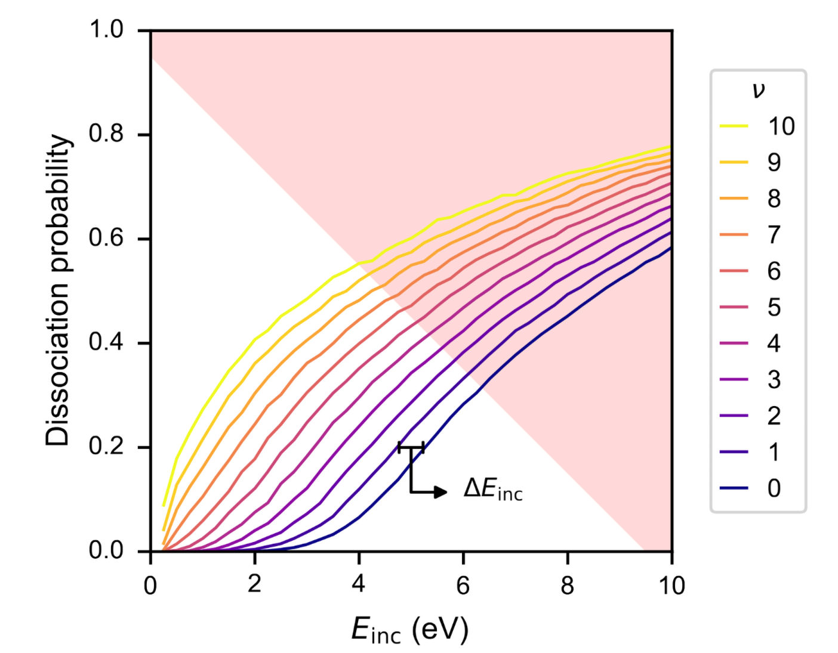
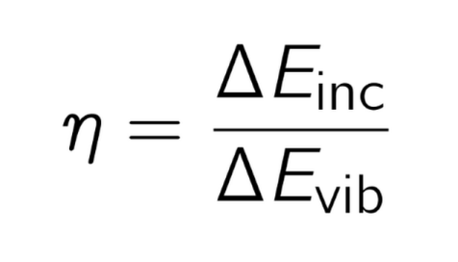
Vibrational Efficacy
Dissociation Probability
Vibrational excitation increases reactivity
Excitation corresponds to Energy shift
Vibrational Efficacy:

Slide 11
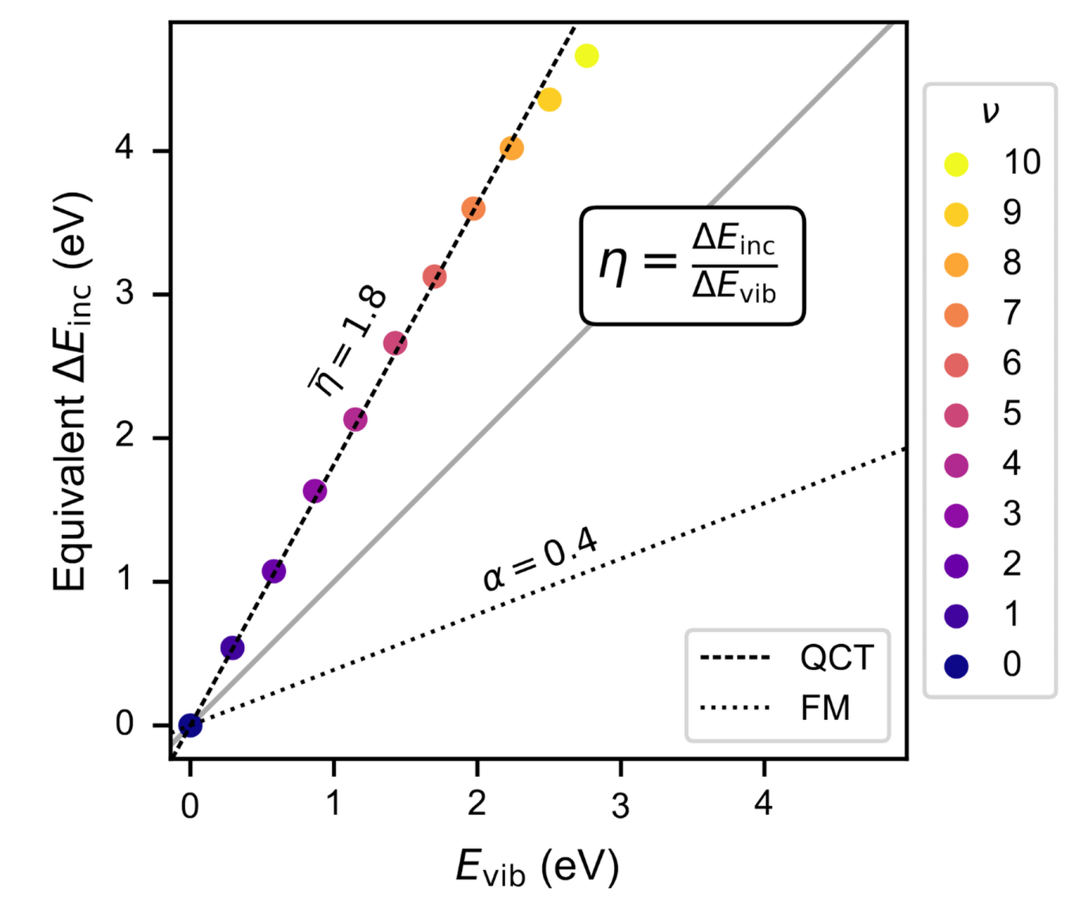
Vibrational Efficacy
Dissociation Probability
Vibrational Efficacy

Slide 12
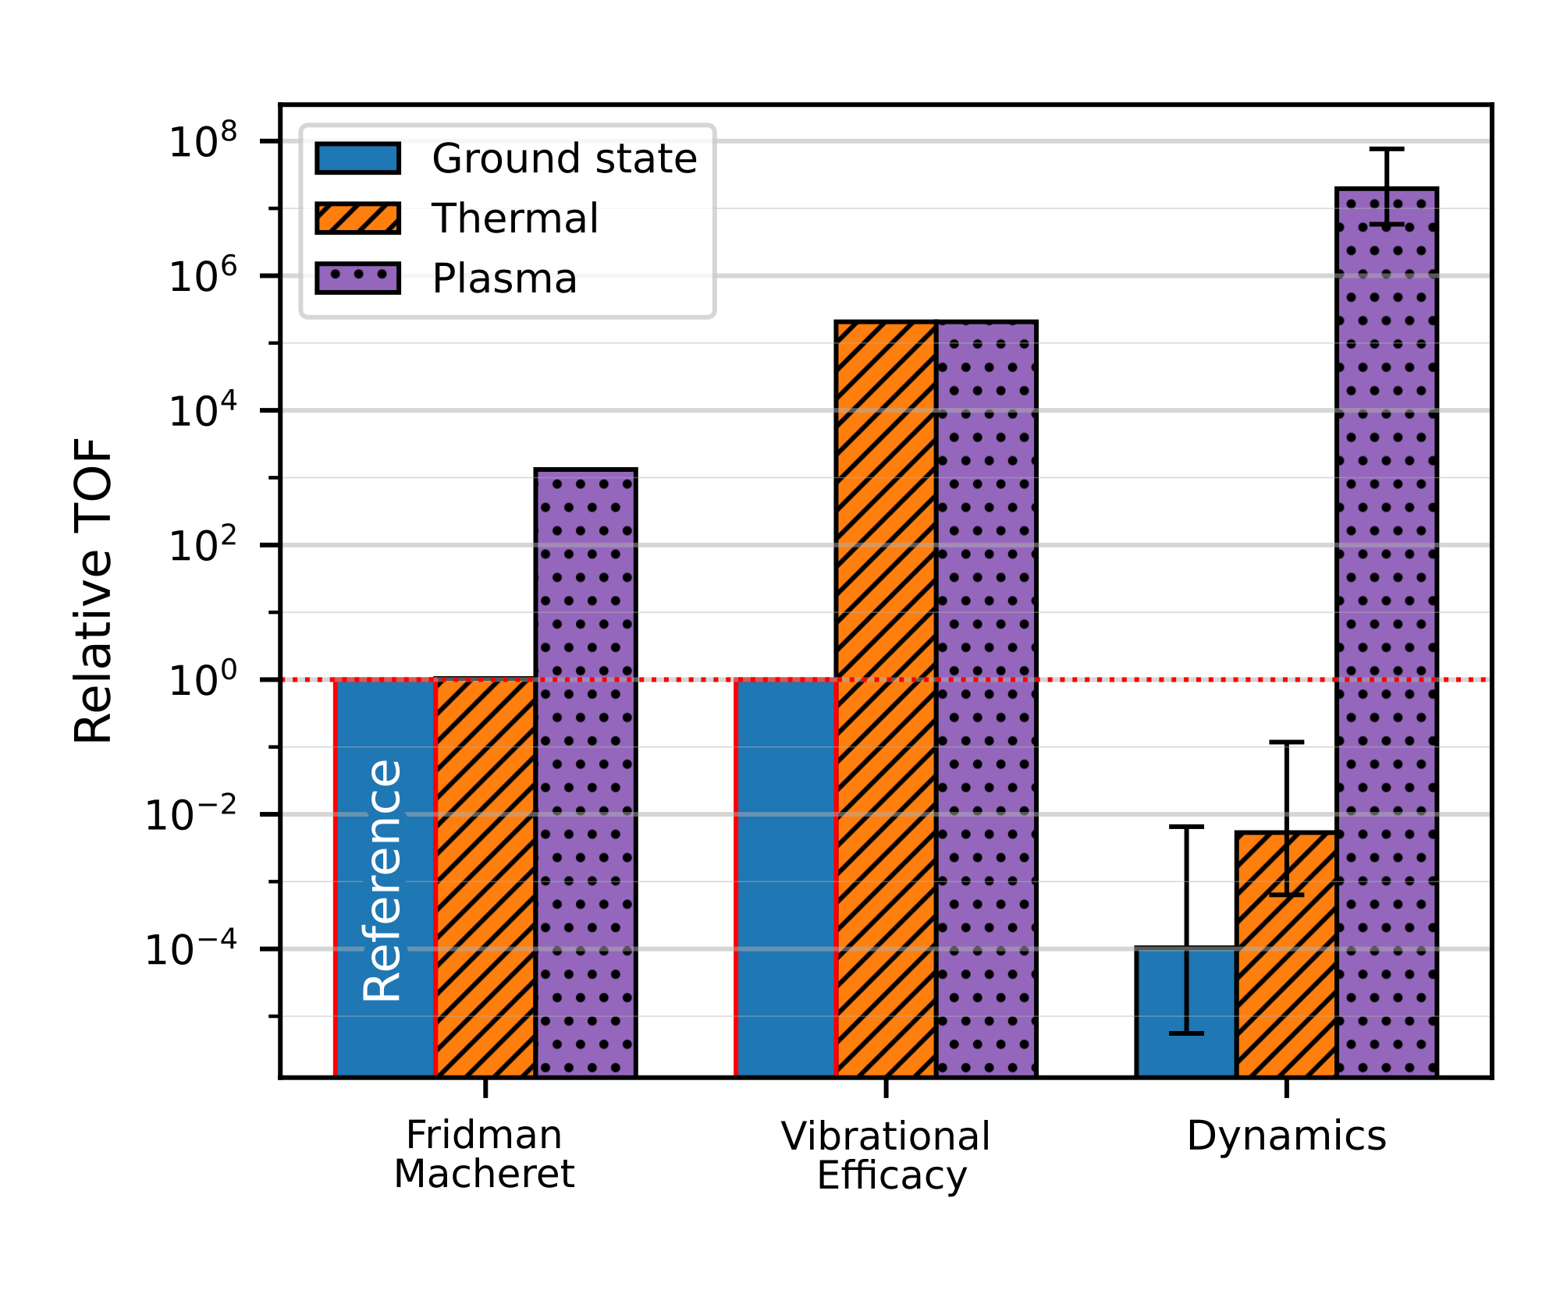
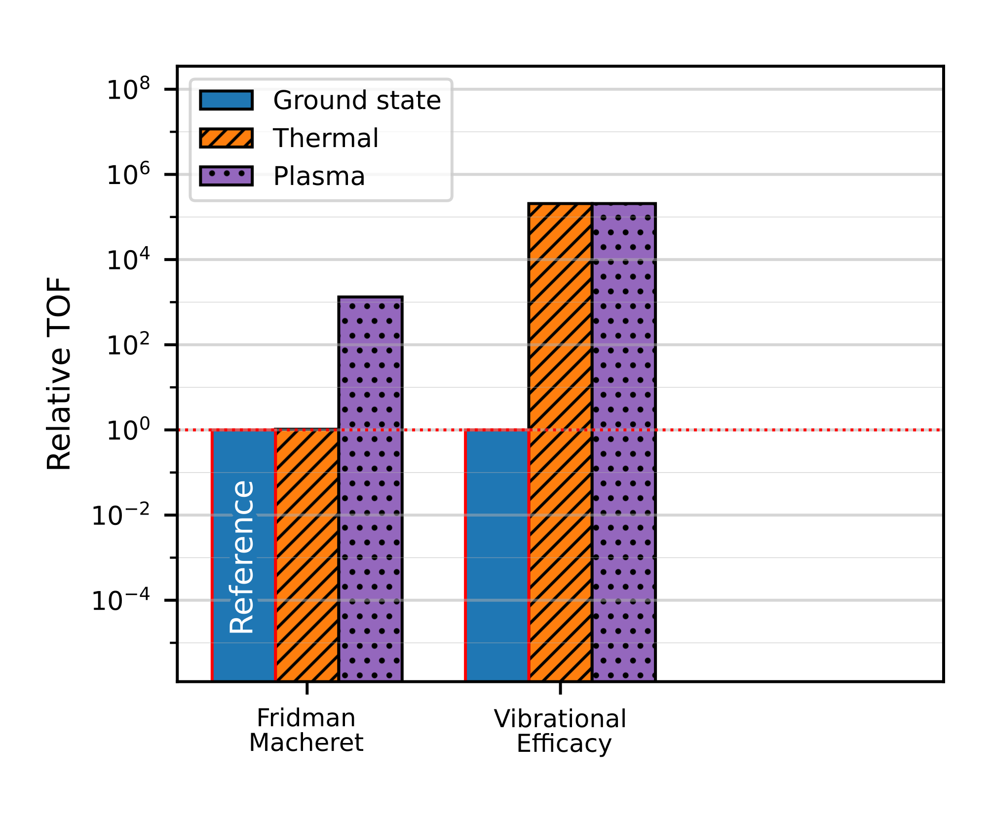
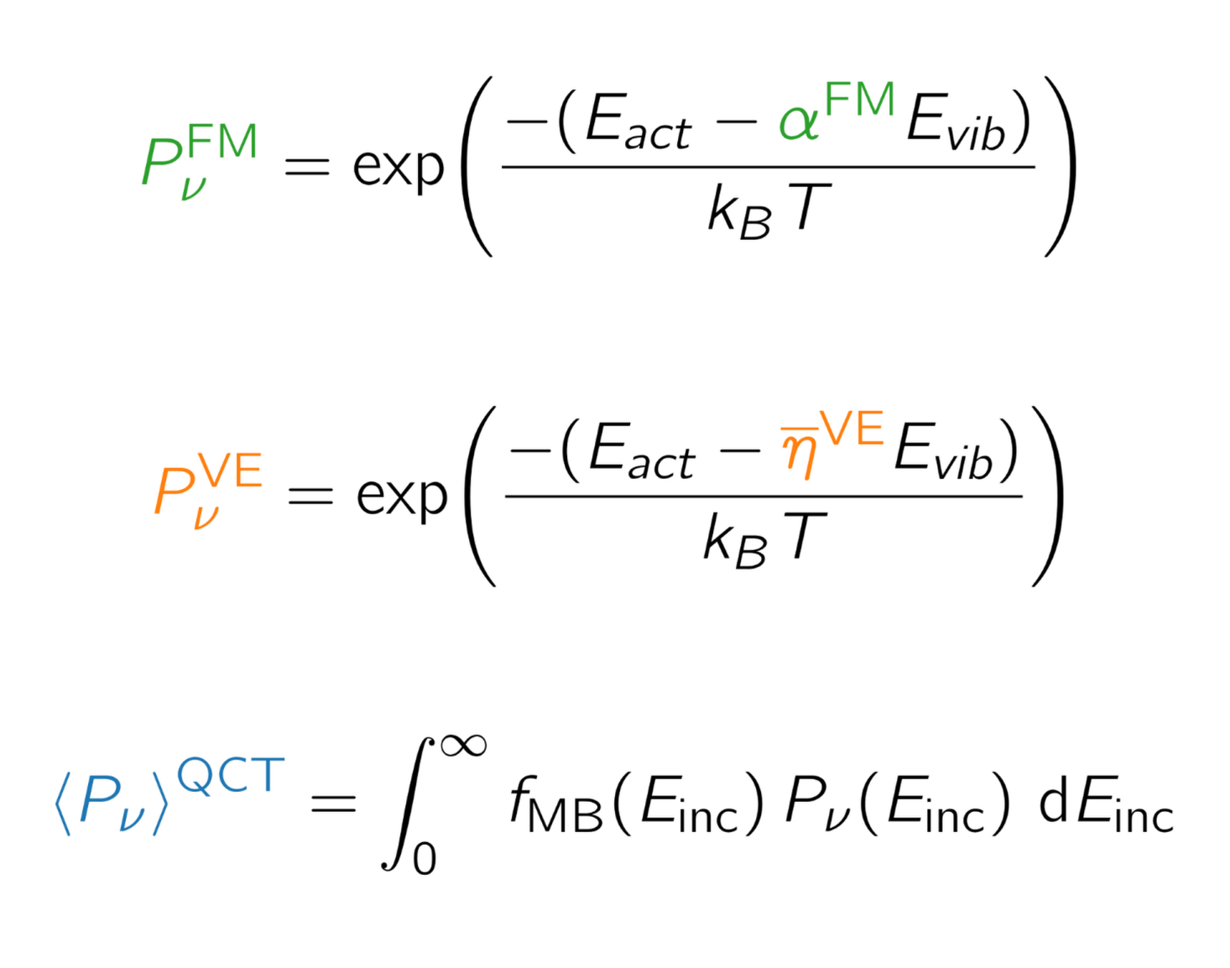
Rates from Dynamics
Substitute Vibrational Efficacy into Fridman-Macheret equation
Fridman
Macheret
Vibrational
Efficacy
Dynamics

Slide 13
Take Home Message
Vibrational Excitations have major influence on reaction rates
Even for Thermal Catalysis Vibrational Excitations dominate
Dynamical effects lower base reactivity
Fridman
Macheret
Vibrational
Efficacy
Dynamics

Slide 14
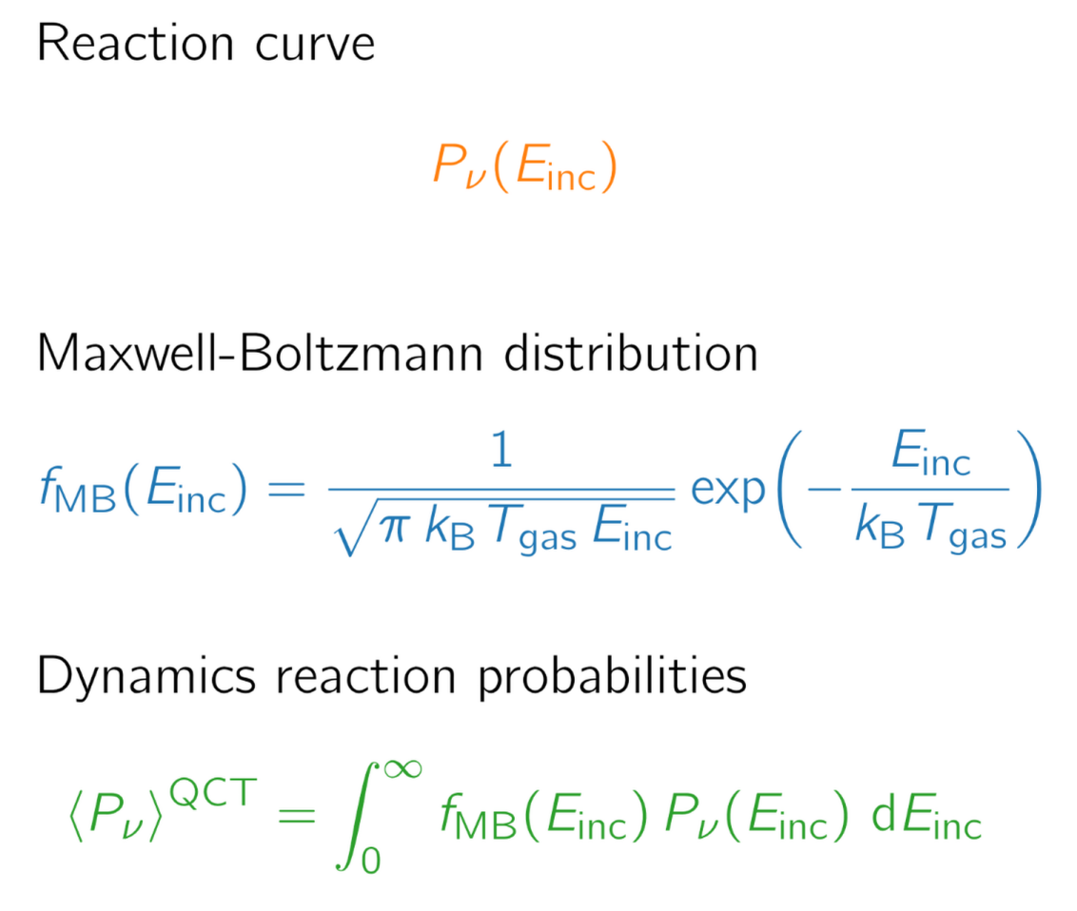
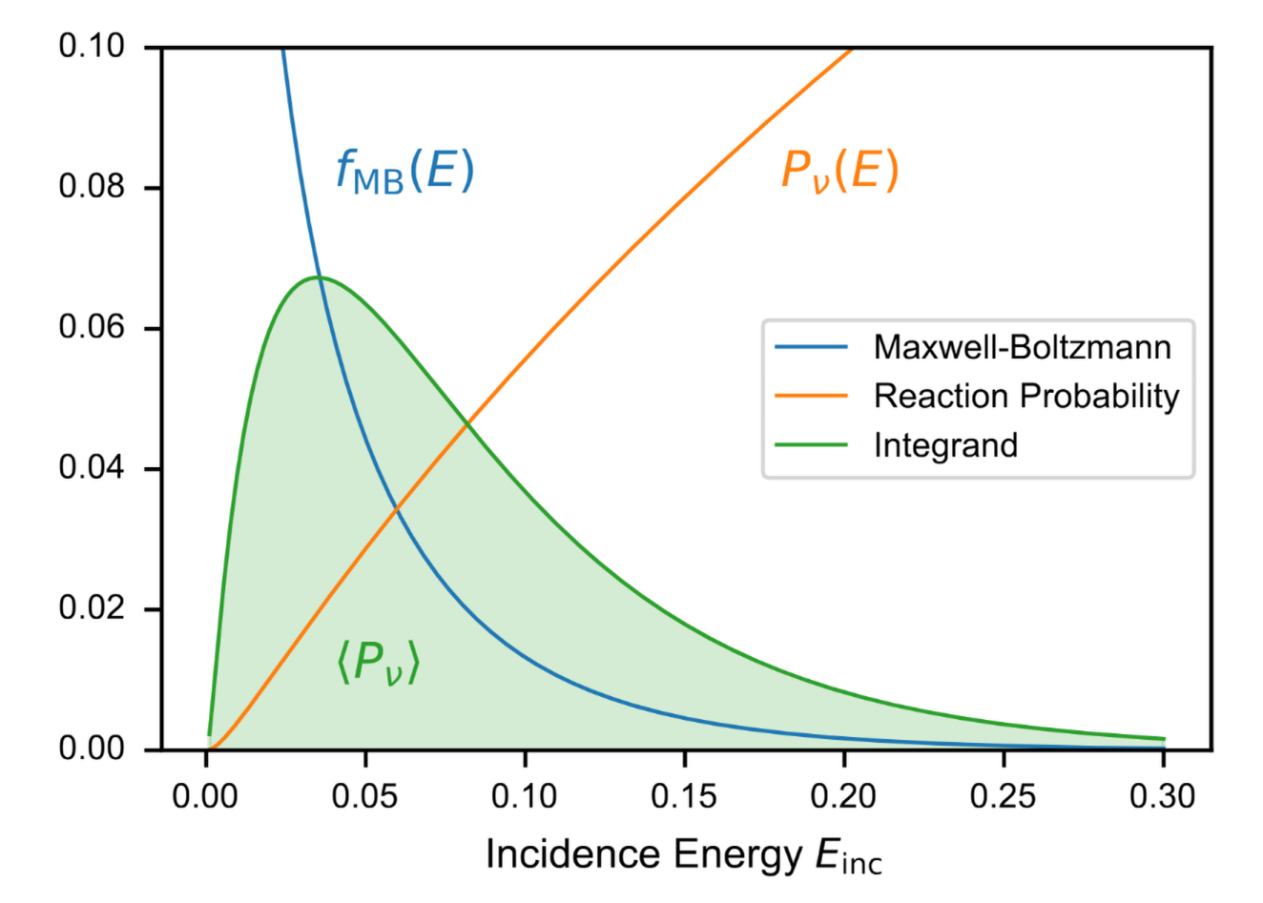
Probabilities from Dynamics

Slide 15
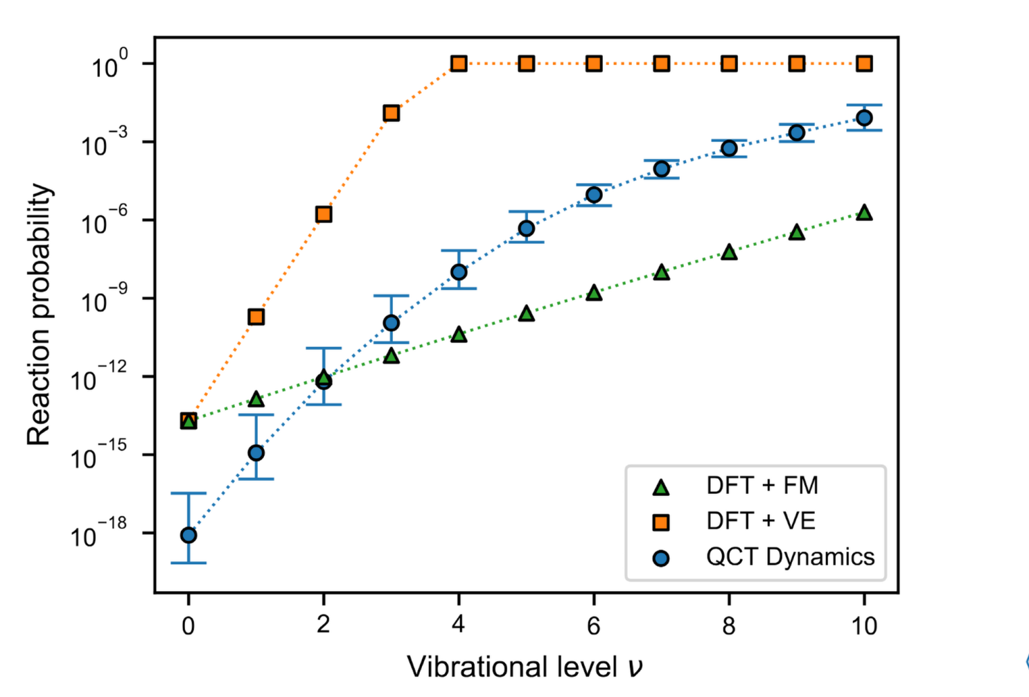
Dissociation Probabilities

Slide 16
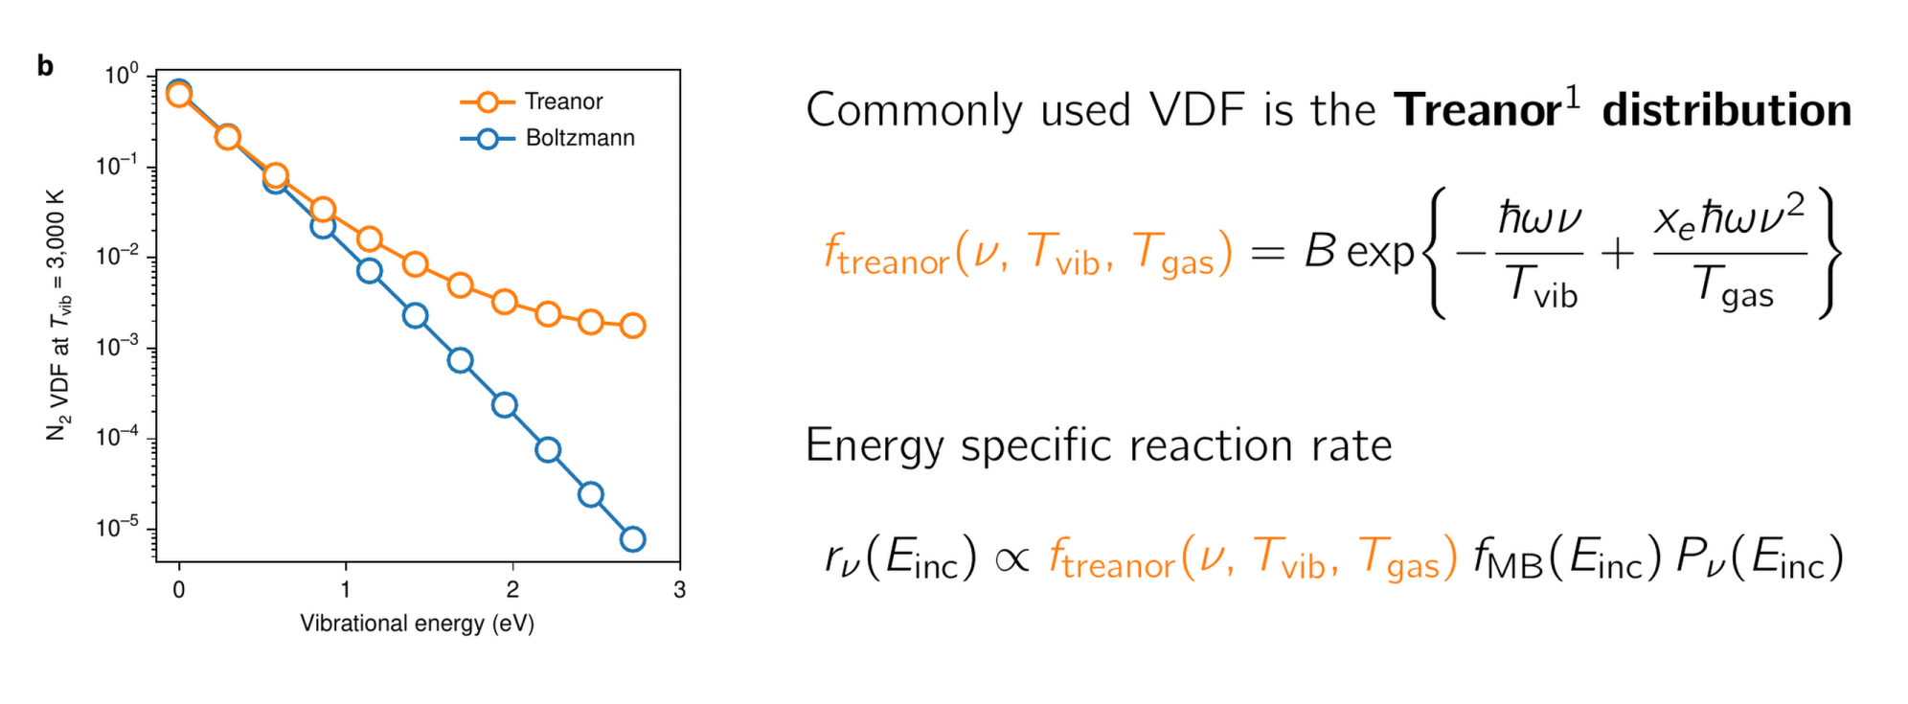
Vibrational Distribution
Treanor, C. E. et al. JCP (2003)

Slide 17
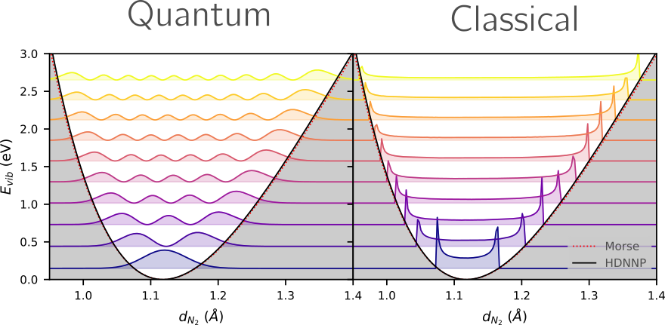
Vibrational Quantization
Wavefunction → Classical Oscillation

Slide 18
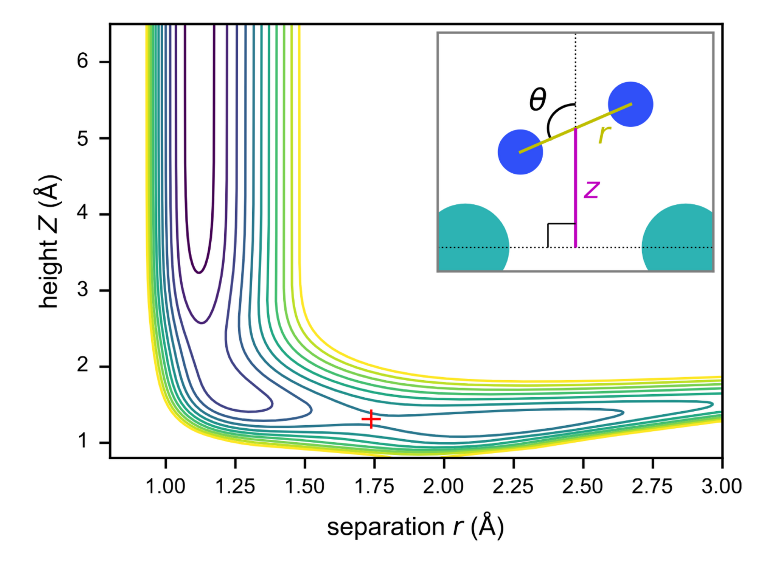
Potential Energy
Incident Momentum
- before the bend
Vibrational Momentum
- After the bend

Slide 19
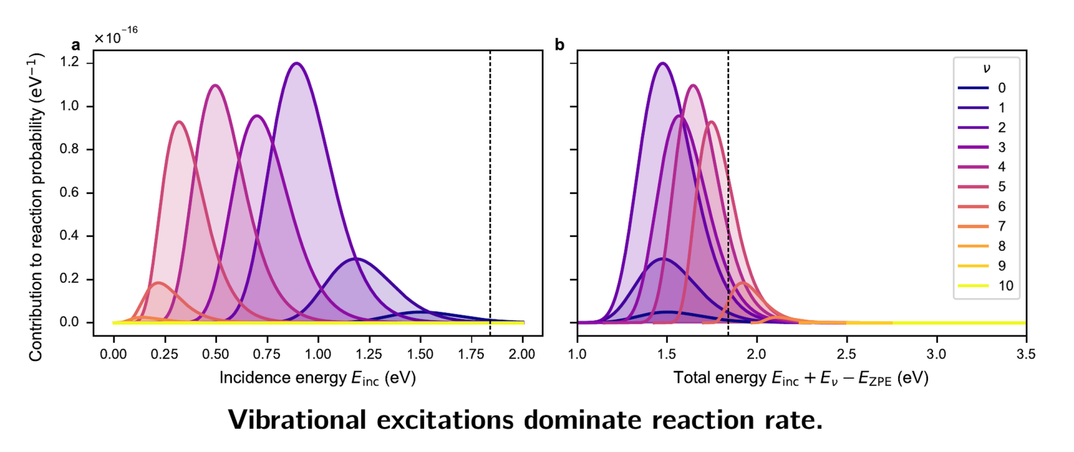
Thermal Contributions

Slide 20
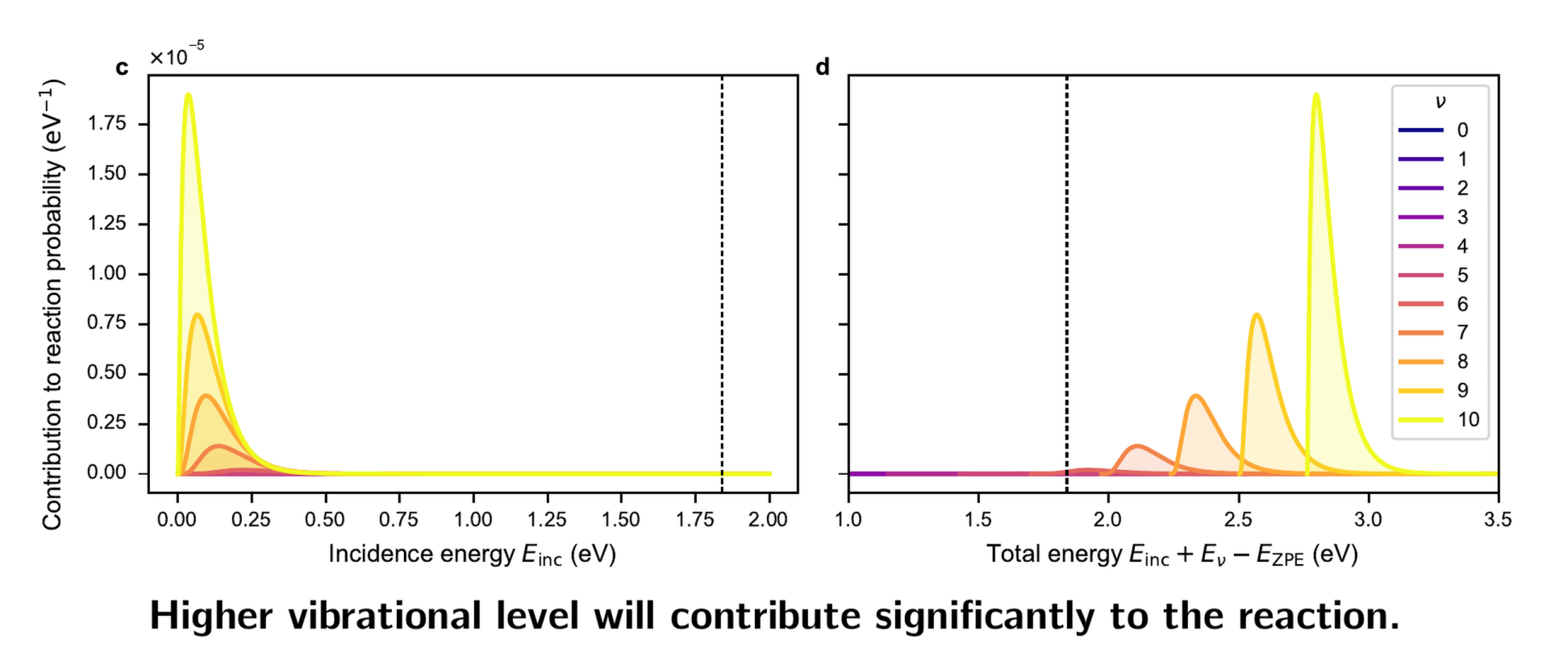
Plasma Contributions

Slide 21
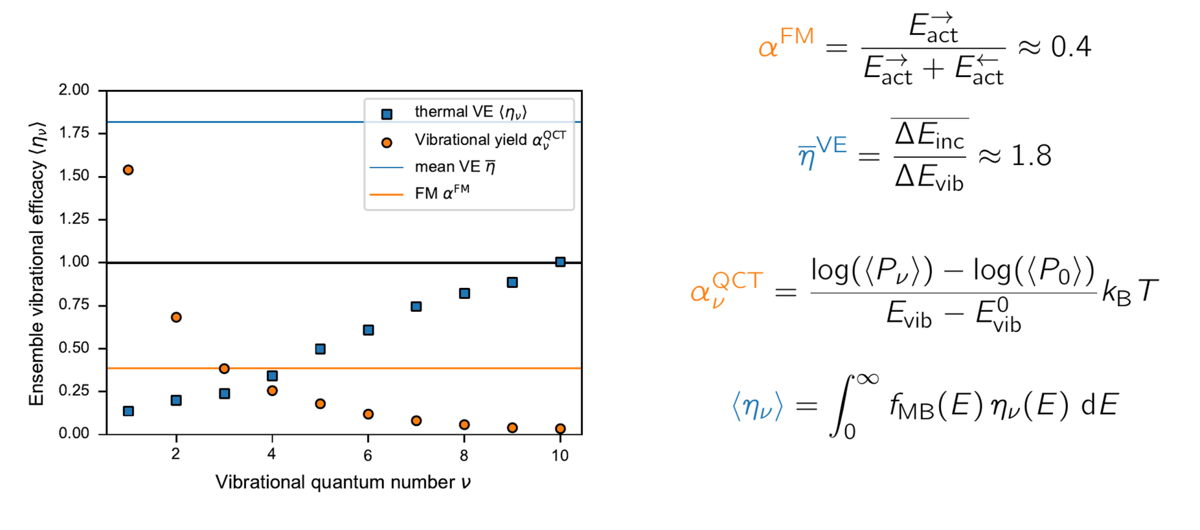
Thermal Vibrational Efficacy
Kedalo, Y. M. et al. JPCC (2023)

